Slide 1
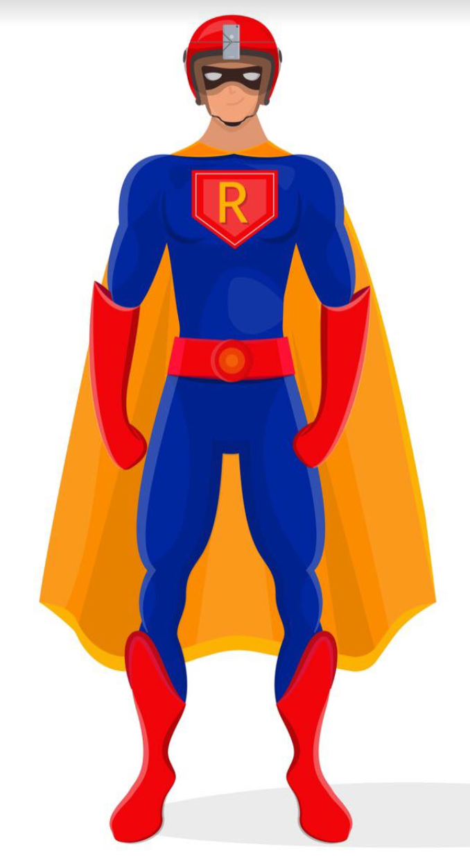
Ravi Reporter
June 15, 2021
New York
Notes:
Hello
Today I want to talk to you about the Ravi Reporter App.
Now this is an app that will allow you to be a superhero ….

Slide 2
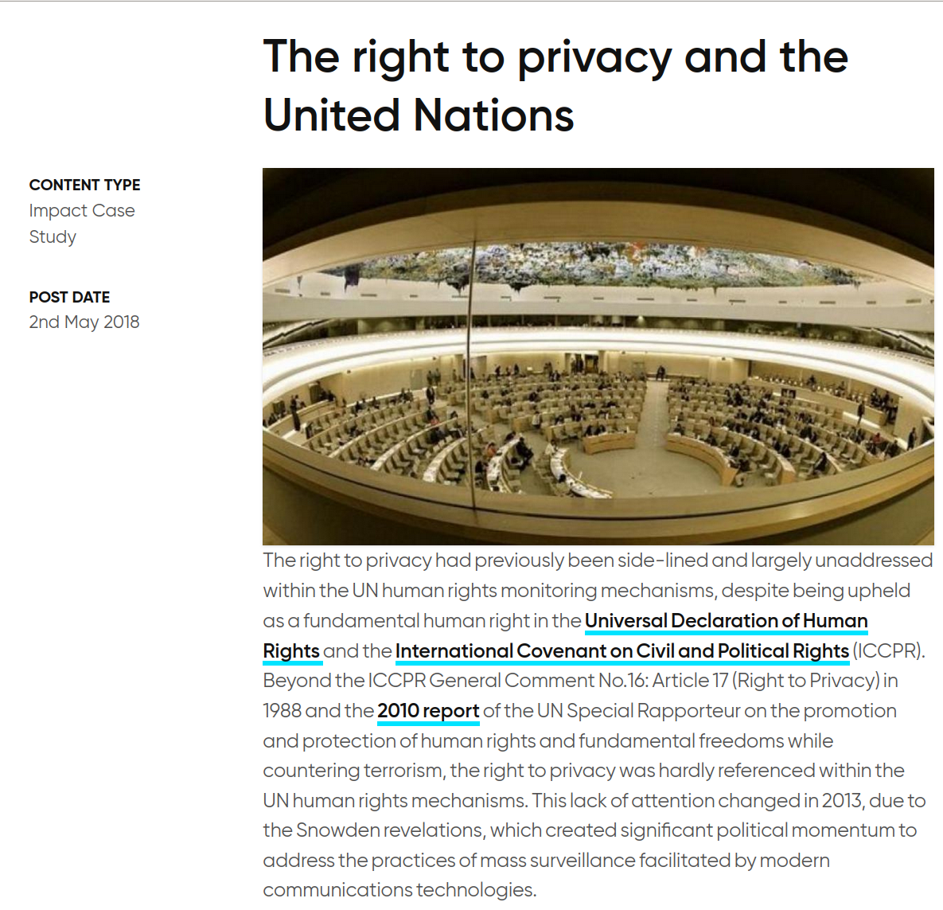
Videos, Cell Phones, Privacy
Billions of Cell Phones and Videos
Save copy on some cloud …
Privacy
Protection from arbitrary or unlawful interferences with their “privacy, family, home or correspondence.”
Notes:
We live in a world with videos and cell phones. And we do not know how much privacy we have
Most people record videos on the cell phone and save it in some cloud
The interesting thing to note is that the general concept of privacy may not apply to such digital assets – or at least there are doubts and concerns as noted in the right margin - as to how much it applies or should apply ...
This is not a healthy situation for our society

Slide 3
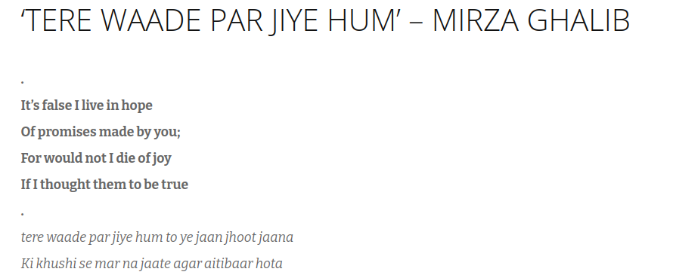
Current Social Contract
I save my videos on some cloud
Without knowing for sure who else could watch it
Broken
When I delete my account
Was video deleted?
Several broken-trust events
Can we get total control over our own data
If Privacy is indeed a Human Right
Notes:
The social contract is that I save my videos on the cloud – but – I am not sure who can watch it … This is broken
Companies dont have much interest in clarifying whats private and whats not. Users are also quite busy and keep agreeing to whatever “privacy” policy the company wants them to agree to …
Similarly when I delete – there is no assurance. However there is a long history of leaks where what was “deleted” was later leaked …
Which is why poet Mirza Ghalib comes to mind – he knows the lover’s promise is false but he pretends to believe – Just like we pretend with the tech giants we will get privacy/control/no lockin/etc …. (just because we love them).

Slide 4
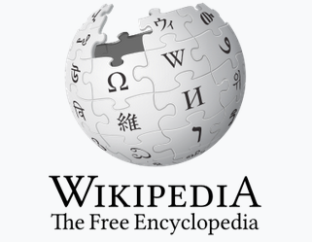

Proposed New Contract
Open source approach eg: Linux, Wikipedia
Any assurance of privacy etc is verifiable
Open to review
Security fixes
Video Recording App
Crowd funded
Open sourced
Best level of privacy protection
Doesn’t need you to buy anything
Doesn’t and can’t sell your data by design
Notes:
Therefore we propose a new contract
We will take the open source approach, which is also taken by Linux and Wikipedia
Any assurance will be verifiable. When faults will be found they will be fixed. The process will be transparent to any one on earth
Using this approach we want to build the video recording app which we are crowdfunding
We want to give best privacy and protection to simple users plus the app doesnt stalk them or their data. Nor would it try to lock you in.

Slide 5
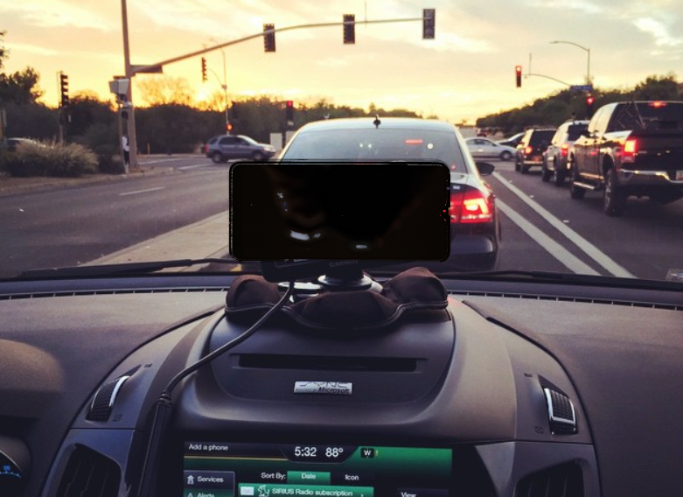
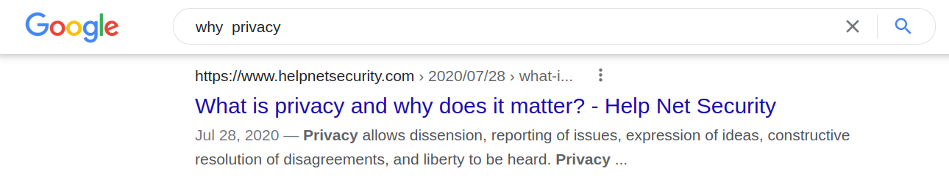
What Privacy Buys Us
Freedom – to do what we please in the privacy of our home
New applications
Since the app is not watching me but watching the environment on my behalf and within my control
I can record my driving continuously
Produce evidence in court I was not at fault
And many more ...
Notes:
If we follow the new contract – what does the privacy buy us? Freedom … to do what we please within the privacy of our own home
Notice that although its our own home, our own phone, and our own video, yet we do not have full freedom because we do not have privacy. But if we DID have full privacy, we may have new applications.
I could drive with the camera, (knowing the app is respecting my privacy), and when there is an accident, I will ask the app to upload the video which I will later produce in court as evidence. People will do this diligently only if they were completely sure that no one will gain access to the recording without their (informed active) consent. This works just like traditional evidence. Even if one person tries to hide their bad actions, others can become witnesses ….
Having privacy gives this better world where we can feel empowered to take full advantage of things that belong to us (the cell phone, the video). This is not the only use case, there are many others.

Slide 6
Ravi Reporter App
Recorder
Authenticated video
Authoritatively certify place and timestamp of video
Many uses, eg: send video to your boss when car broken on highway …
Private video
Stored encrypted in cloud – $$$ beyond basic usage
Only you or people you shared the video with can access and/or play your video
Truly anonymous video
If you wish to take away risk of recording
Later claim credit for the video in a provable manner
Notes:
The Ravi Reporter app is essentially a video recorder which provides first class security properties for everyone. We want to authenticate the place and time stamp of the (event recorded in the) video. Many many uses.
Our videos are private! As a user, its my video, and I want to ensure it is stored securely and encrypted – in the best state of the art manner. And only I, or people I share the video with have access to the key – and therefore the content. This should be a property we can verify in open source
If we store video, there will be a cost. Typically the power users premium paid users bear the cost of the free-tier light users – we can follow the same basic model
Finally we have truly anonymous videos (!) – which is a feature we introduce with this app. Suppose you want to record the video but want to avoid getting caught in the process of recording the video ...
The app in the anonymous recording mode will record and upload while pretending that the phone is dead (to the best state of the art). Even though the user information wont be transmitted, the recording will become available when the user claims it. This is done using ACR and Blockchain.

Slide 7
Ravi Reporter App
Share & Play
Dual goals
Follow the leaders in share and play features while having better privacy and security
Have quick path to simple product
Open source extensible UI for extensible skins, widgets, etc
Which run in secure sandbox
Ethical TikTok
Notes:
We follow the current leaders in sharing and playing videos. The playing and sharing functionality will likely grow with time as there will be an open source extensible approach allowing users to share and play videos with any of several open source skins and widgets
The open source idea here is identical to the one that some file systems and device drivers were written significantly after Linux was fully operational as a very simple operating system
We will attempt to run the extensions in secure sandbox in the best state of the art manner. Perhaps eventually we will have an ethical clone of TikTok !

Slide 8
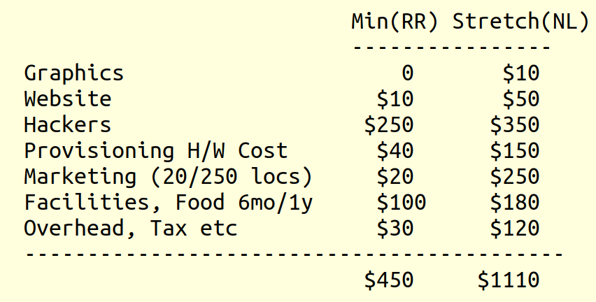
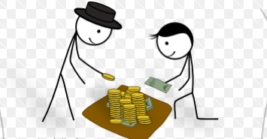
The Campaign
Ravi Reporter (RR)
Video recording with first class privacy and security for the user
With 0 intentional back-doors
6-9 months, $450K est.
New Libertie (NL)
Futuristic de-biased real news platform (described later)
Built on top of crowd-sourced newsworthy Ravi Reporter recordings
Notes:
This is the campaign for the Ravi Reporter app – which is a video recording app with first class privacy and security “for the user” i.e. no unnecessary data harvesting, has 0 intentional back doors, is open source and we want to use it ourselves
Not a big effort. 6 months with 8-10 hackers. The financial estimate is sketched. Notice we can do a lot more if there are a lot of anonymous Ravi reporter recordings.
We can make a futuristic news platform which is scientifically insulated – in a best effort manner - against bias in a measurable way using the blinding techniques used in drug and vaccine trials
This real-news platform could make a big dent against fake news
The campaigns are listed and estimated budget is sketched. Numbers listed are in 1000s of USD
We appreciate the support.

Slide 9
The Story
Related prior work
Local social networking – Icebraker App developed around 2012
Coercion resistant anonymous verifiable voting - NewLibertie – open source advanced voting based on homo-morphic encryption – initially intended to run a facts based news social network
The insight
People will use video for a lot more IF we do privacy and anonymity right (really right)
As a stretch goal we can make a provably balanced and verifiable news platform – optional gory details in appendices for those interested ...
Crowdfund campaign
Exit as Not-for-profit in order to make private and authenticated videos a global public good just like Wikipedia and Linux already are ...
Notes:
The background story is like this: There was a local social networking app called the Icebraker which we developed around 2012. The idea here was to be able to scan the bluetooth neighborhood and then associate faces with these locally visible Bluetooth identifiers of the cell phones, thereby allowing complete strangers to connect with each other.
Lately there was some work we had done trying to create a facts based news social network with anonymous voting and be able to arrive at interesting conclusions. Part of that work is done, the anonymous voting service part, and if you think in completeness, if lot of people start using the Ravi Reporter app, and we add this technology for anonymous voting, then we would have an authoritative first class news platform also.
Anyway the insight is that people will do a lot more video if we can do privacy right. Right as in really right. Smart people can check for themselves that it does what is claimed. Instead of trusting someone. And we will get an open source blinded unbiased news platform - almost for free
Further details on each of the above are contained in the following slides. We will provide any information as needed to clarify the design being described here. But to make sure this video platform survives against competition which subsidizes its cost by harvesting user data, we want to exit as not for profit. Just like Wikipedia and Linux are available to anyone on earth for free, why don’t we make private authenticated videos a global public good. Any one in the world can use it.
I want to know if my daughter sends me a video from the birthday party, the video vouches for its place time and integrity and thereby the safety of the daughter, and its not saved in a way that anyone else other than me or her can see it. These are the properties I want. And perhaps many people on the globe also want it. And thats why we should build it.

Slide 10
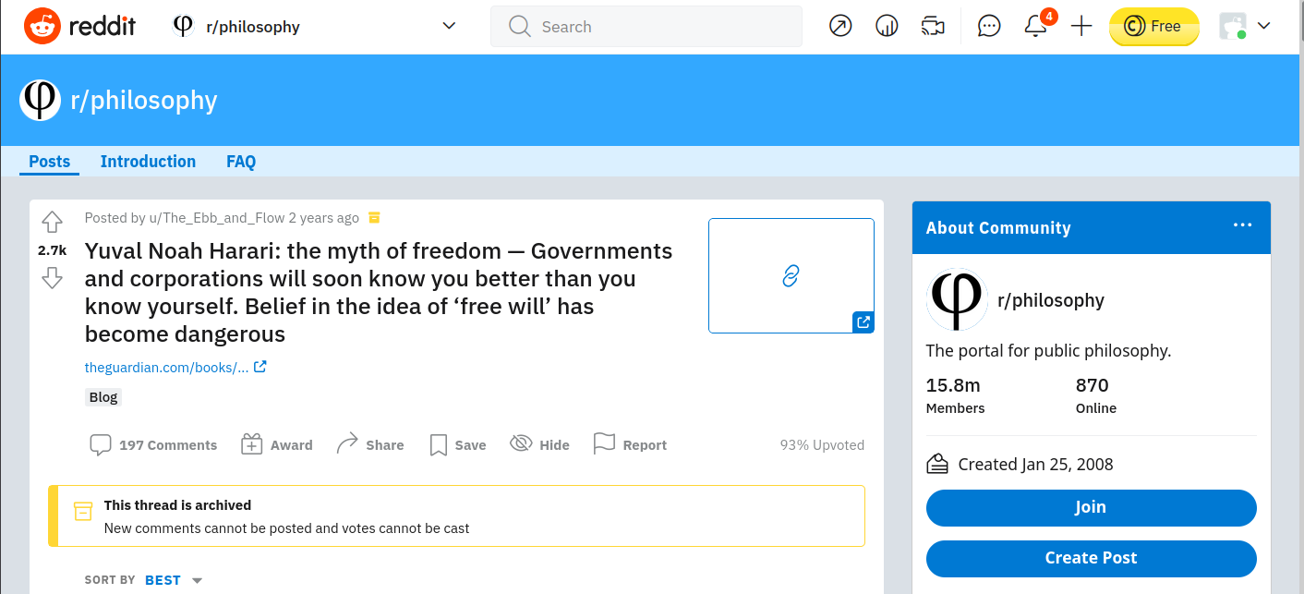
Why Is This Important?
Yuval Noah Harari
Bestselling author, Historian, and Professor at Hebrew University fears a doomsday scenario
Ravi Reporter is a serious attempt at this problem of historical magnitude
Notes:
It is also very important to do this. Not only as a personal technical hobby, or as a family need.
It seems we are heading towards a dangerous scenario. Because the governments and corporations - according to Professor Harari - know more about me than myself. When this happens, there is a doomsday scenario because I can be manipulated to do whatever these people want.
But I have good news for Prof Harari that if we have 100,000 people chipping in $5 each, then this future will not happen - it will not happen for video. And once we know how to do it for video, I bet we can do it for anything else that’s important.

Slide 11
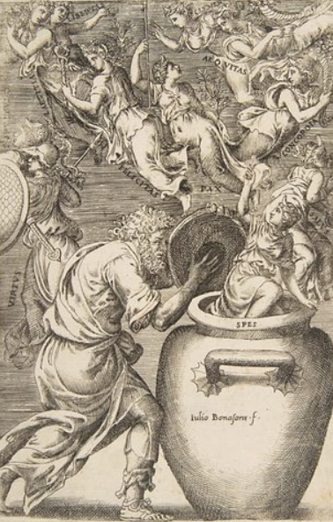
Thanks for Support
Sophisticated Issues come out from this privacy preserving Video recording app
Technology, Journalism, Ethics discussed in depth in the following slides
All check out
Please consider supporting even if you don’t have time to verify in depth
Appreciate messages of support, translation to other languages, in addition to financial support or actual support through labor
https://fundrazr.com/RaviReporter
Notes:
We would like to thank everyone who has invested and who will invest.
We understand sophisticated issues come out of this. We give this enormous power in the hand of the user, and several things come out of it. But we are not taking that negatively, and as far as we can tell, all of these issues check out.
Check out in the sense that we understand them and can solve them in a practical usable and socially useful manner.
Therefore please consider supporting even without going into details - since the details are of interest mostly to the people having expertise in those specific disciplines.
Your support is highly appreciated.
Thank you very much.

Slide 12
Ravi Reporter
Technology

Slide 13
Precise Usage of Terms
Privacy of Recorded Video
Video is stored encrypted on cloud
Key is on your device
No worry of lock in – it is your data – and if funded we will incorporate as a legal not for profit
No privacy gotcha – code will be all open source
Delete means delete
Anonymity
Identity of creator will be lost in certain ways of using the app
Authentication
Of Place and Time i.e. where and when the video what shot

Slide 14
Technological Limitations
App has stealth mode to allow working in unsafe environment
Phone should pretend to be dead
Requires appropriate “priviledge” and co-operation from operators of relevant app stores
Anonymous video
Claim process will not be 100% reliable
Limitations of ACR technology used in solution
Natural limit caused by information content of the anonymous video

Slide 15
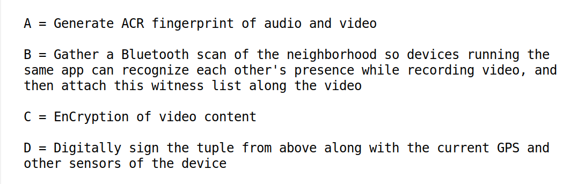
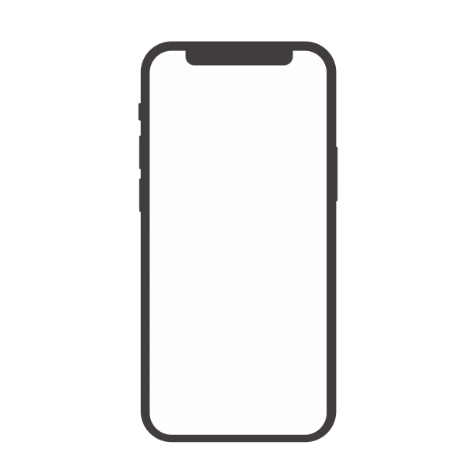
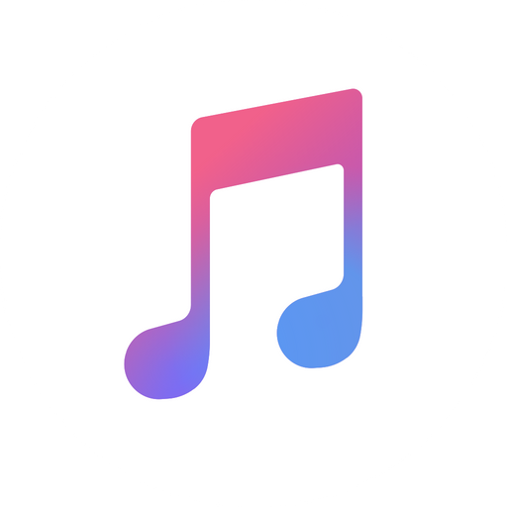



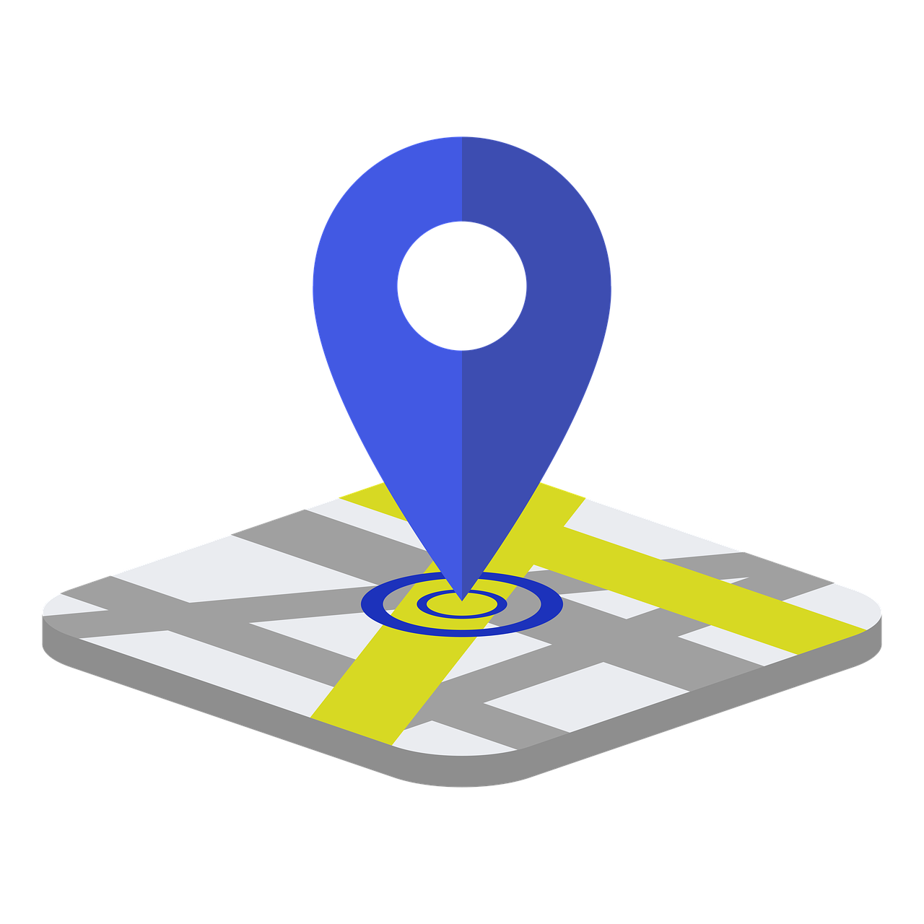
50K View of Solution

Slide 16
App keeps scanning bluetooth neighbors while recording the video
Identifiers and decibels
Saved with video metadata as potential witnesses
Allow users to come forward and claim witness hood either online or in court of law

Slide 17
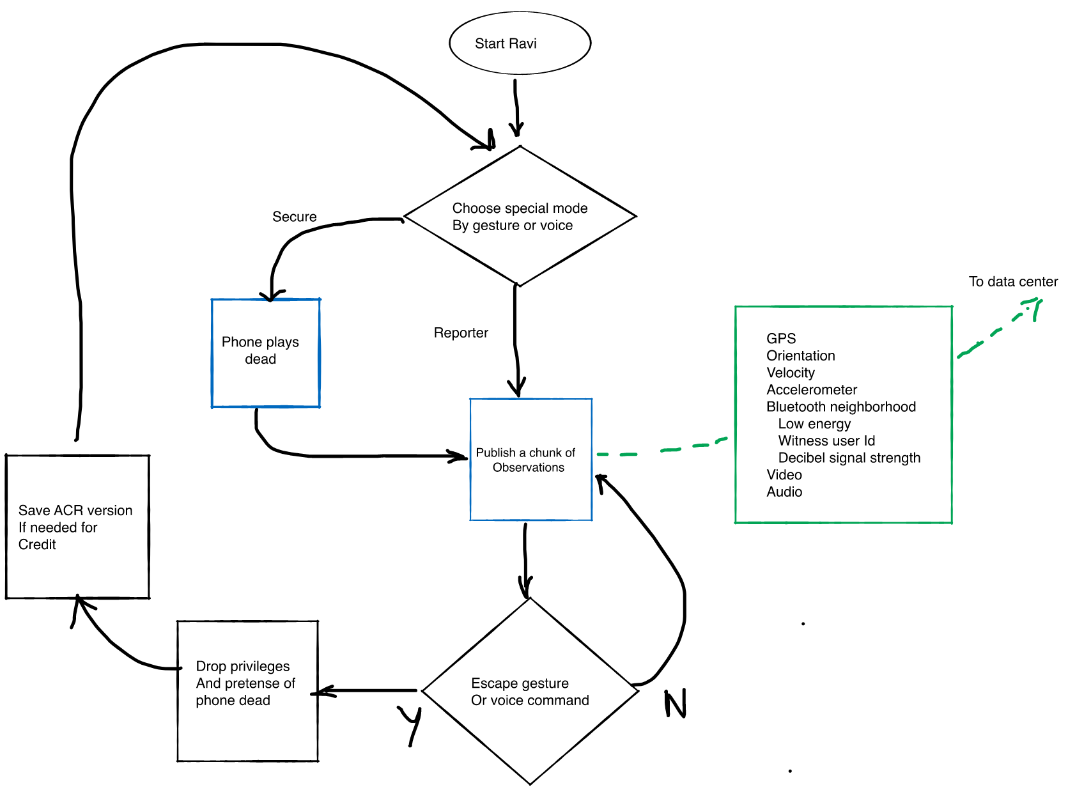
Ravi Reporter State Diagram
Anonymous
mode

Slide 18
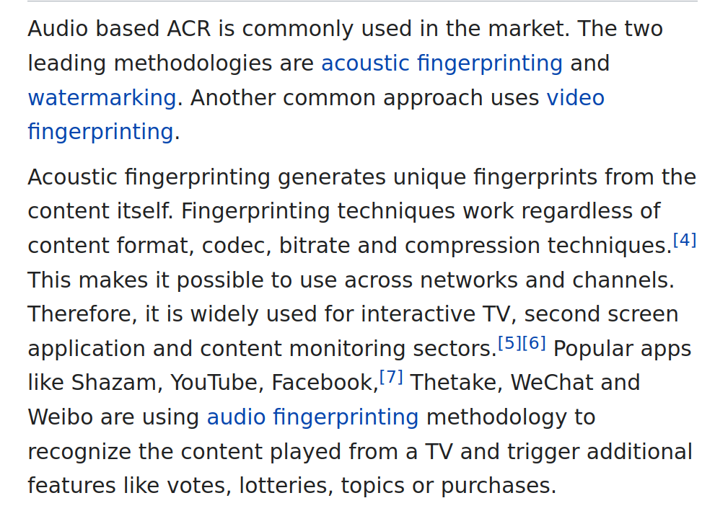
ACR
Convert a video stream into a compact signature – or content fingerprint
Unique to the situation
Other devices recording the same event nearby will match on this fingerprint
We can use this match to
Deduce witnesses
Claim ownership (when safe) by using Anonymous commitment on Blockchain. See next slide
Snippet From Wikipedia
Notes:
https://www.ee.columbia.edu/~dpwe/papers/Wang03-shazam.pdf

Slide 19
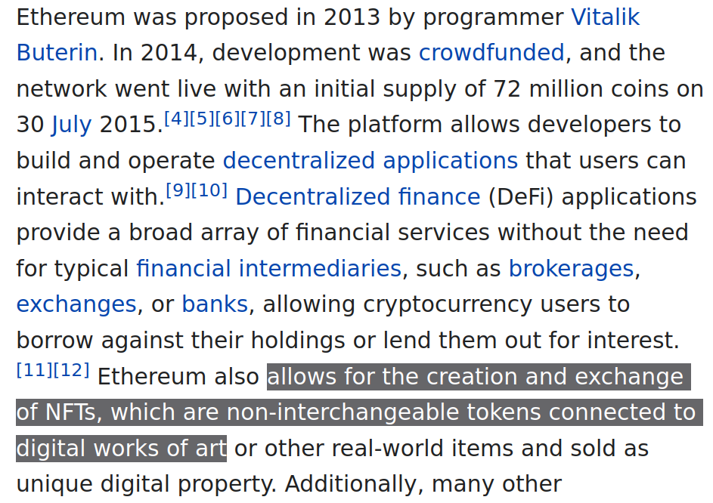
Blockchain and Claiming Ownership
Every video has a unique metadata
Create an NFT which links the userid with the content signature of the video
Without disclosing the userid
SHA( video, userid )
Reporter can claim ownership of video they had to shoot anonymously for safety reasons
Snippet From Wikipedia

Slide 20
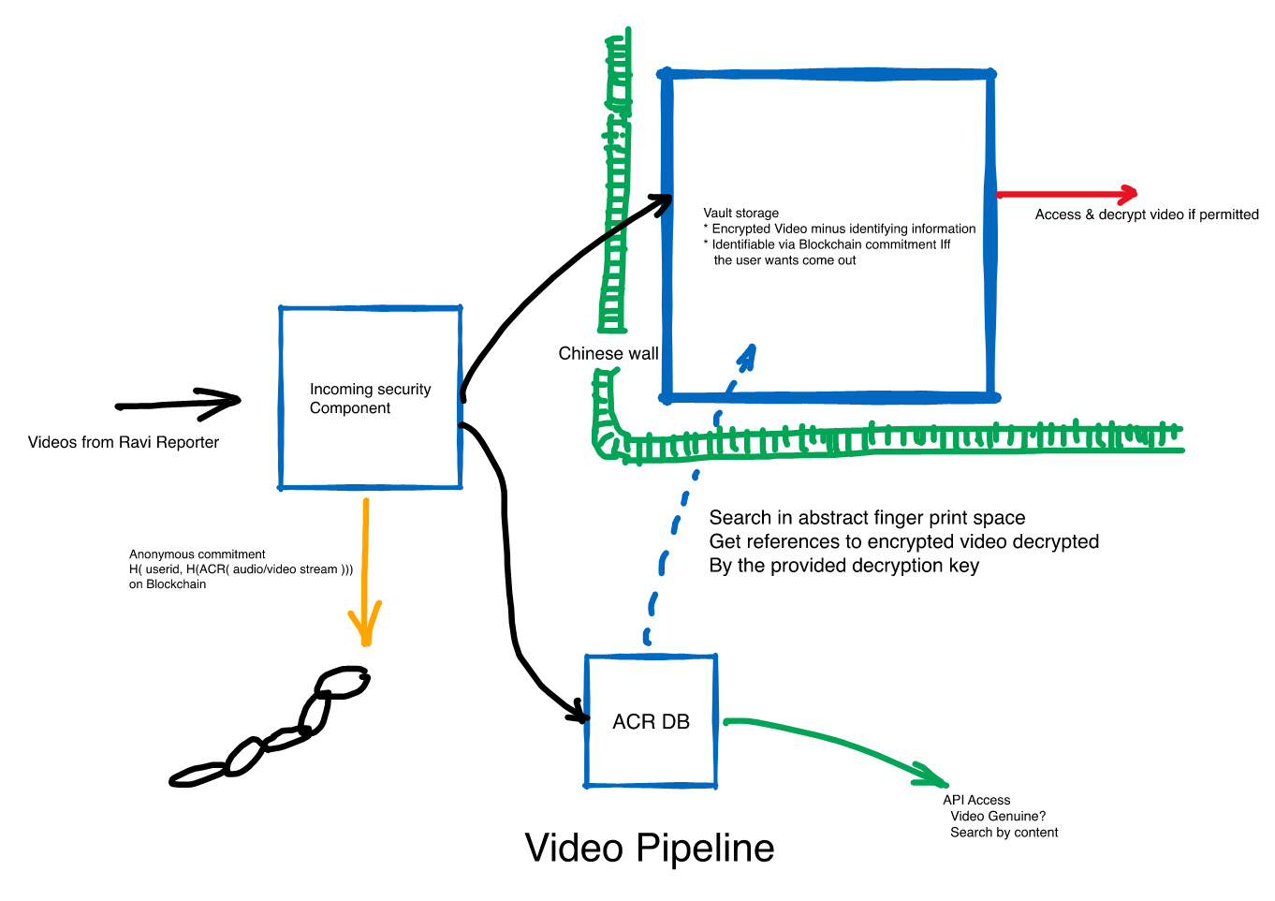
Video Pipeline

Slide 21
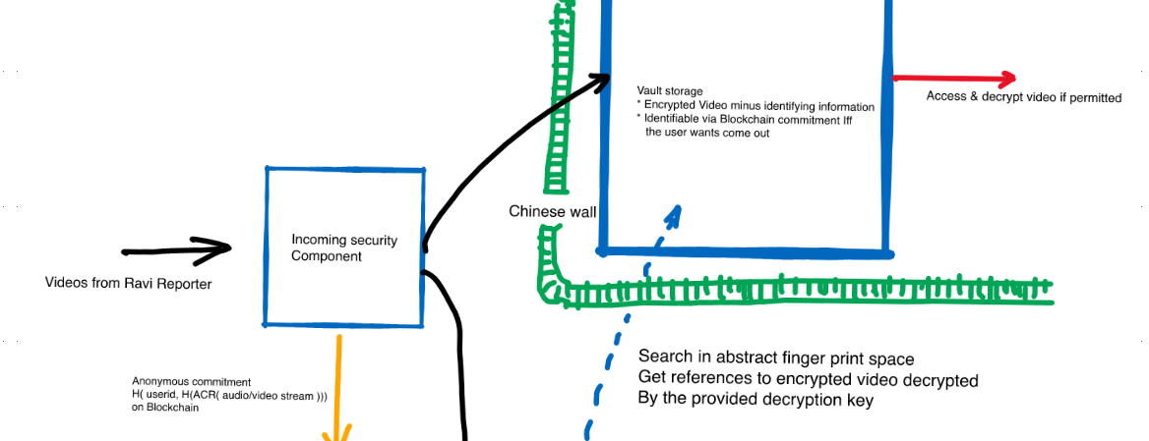
Authentication Bootchain
App published on the appropriate official store has cryptographic features
The secure component can verify if legitimate signature on incoming requests
Then rely on Authenticated timestamp and GPS

Slide 22
Ravi Reporter App
Personal video recorder
Privacy protection via encryption of original data:
Video
Audio
Bluetooth neighborhood
Authenticated time and place of video
Share video if you want
Citizen reporter
Safety via anonymous/stealth saving of video on cloud
Able to later “claim” authorship of video and share
Implemented via Blockchain commitment

Slide 23
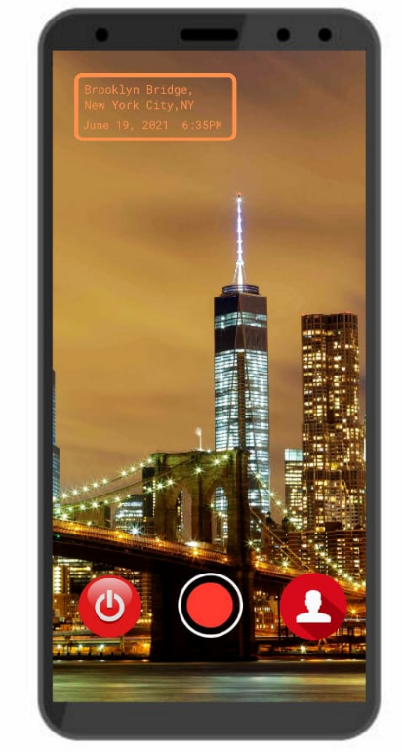


Ravi Reporter
Recorder
Shoot videos with usable Anonymity and Privacy - each video has authenticated GPS place and time tagging
Private mode: The default recording mode
Anonymous mode: Phone pretends to be out of battery (while recording anonymously)
Standby mode: Keep buffering recent video locally in order to start recording with a few seconds of history
Notes:
Firstly the Ravi Reporter app is a video recording app.
In line with the current trend of usable security (signal, firefox, ...) we have usable state of the art security for videos.
The private mode is the default mode.
In standby mode, the app buffers recent video so as to be ready to record “everything from now on plus the last 30 seconds” at any time
In this mode it will be available as a witness to other nearby people doing their recordings

Slide 24
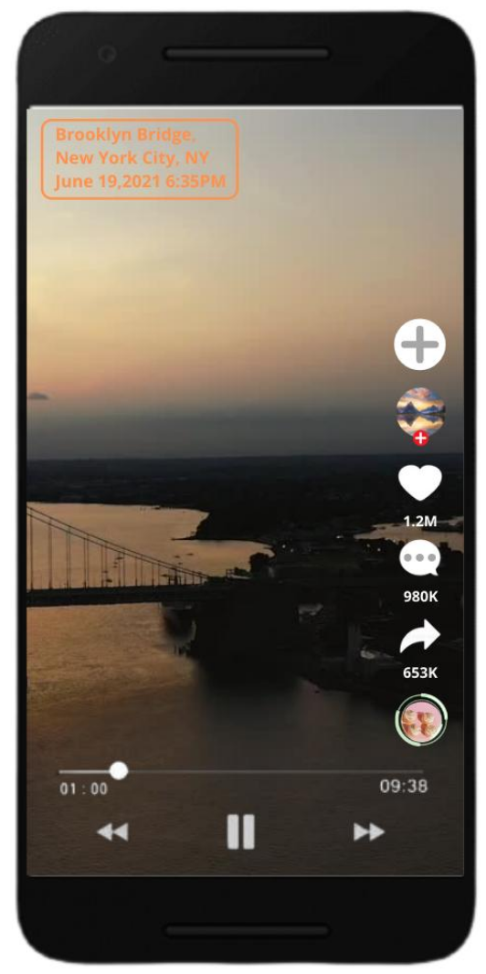
Ravi Reporter
Player
Play them, share them, enhance them ...
Without ever losing track of where the video came from!
Open source approach
Developers can & will add functionality that entertains
Without requiring users to compromise on their privacy
We will enforce with Sandboxed execution
The tools closely resembling TikTok are for suggestion only
Initial version will not have many
Open source community can write better more fun tools
Add more tools using the + tool

Slide 25
Ravi Reporter
Journalistic Issues

Slide 26
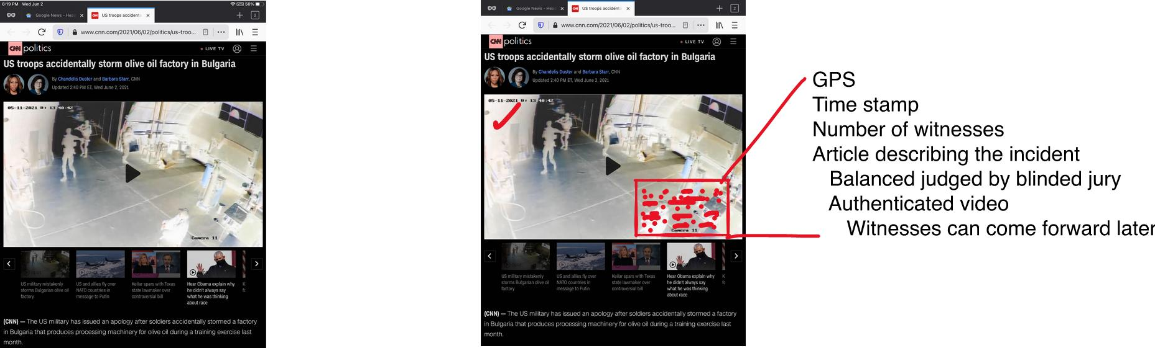
World With Authenticated Video
News organizations will use Ravi Reporter

Slide 27
Building News Platform on Anonymously Published Videos
Journalistic aspects
Safety of journalists
Anonymous publication
Freedom of Expression
Bias
Anonymous voting on blinded videos in editorial workflow
Today no tool to scientifically measure bias
Payment
Optional payment schemes possible outside platform using the blockchain commitment

Slide 28
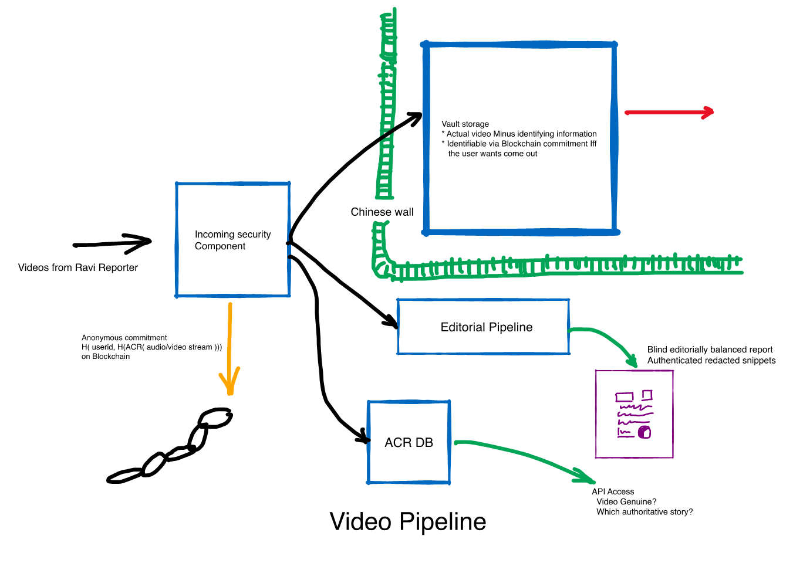
News Platform on Ravi Reporter
Note the anonymous video is stored un-encrypted for later claim

Slide 29
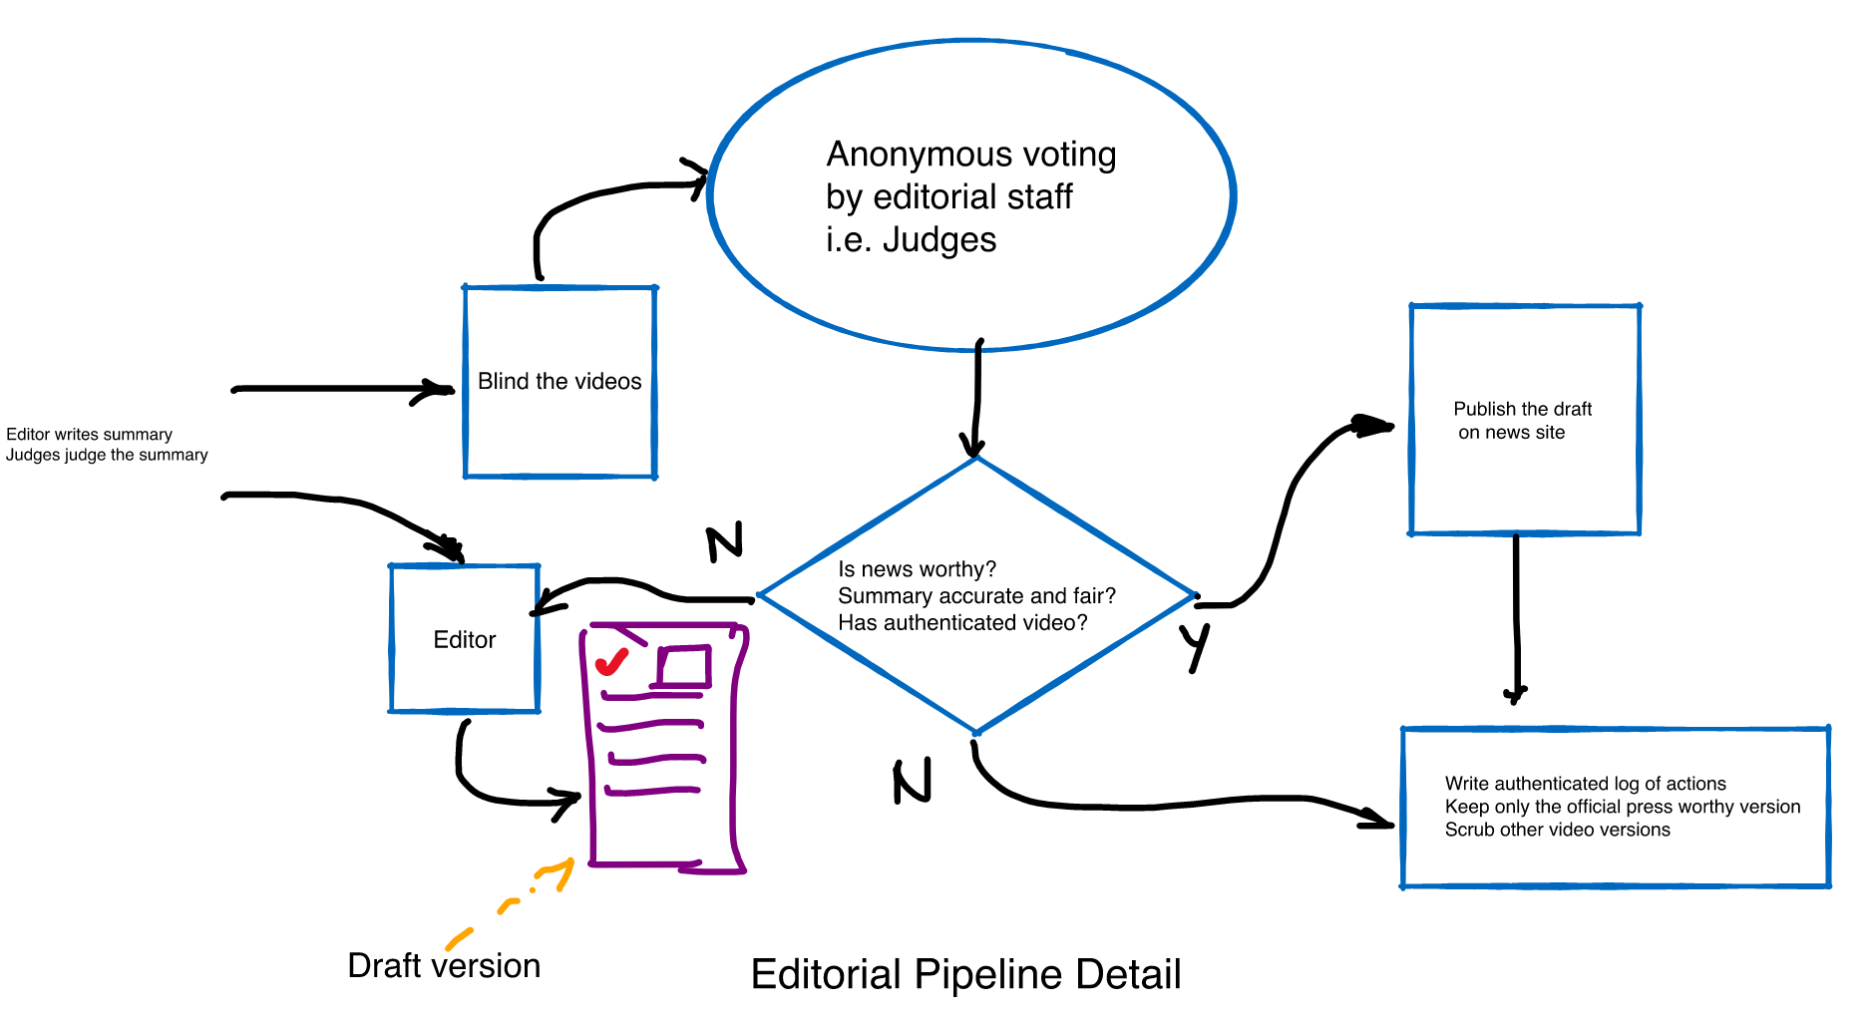
News Workflow

Slide 30
News Platform on Anonymously Published Videos
Social, political, legal issues
Lets take back video
Every video will tell where it came from and when it was shot
Revolutionary in terms of global security (not everyone lives in a democracy)
Back to pre-digital “film” era in sense of privacy
Not for Profit Board: Nominate someone for $1776

Slide 31
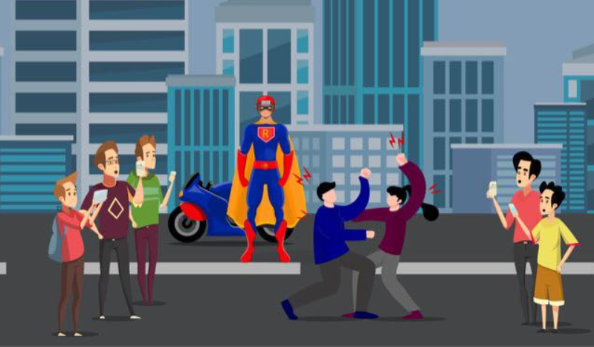
Yes, You can be a Superhero
Appreciate feedback in addition to financial support https://fundrazr.com/RaviReporter or actual support through labor
Questions : message https://www.facebook.com/vpathak000

Slide 32

/Thank you

